Slide 1
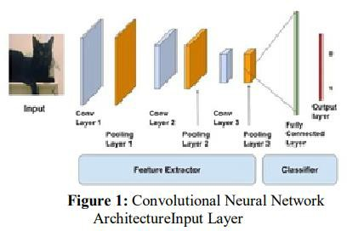
Selected-2 Project Presentation
1.Architecture used in the paper:
Convolutional neural Network has hidden layers, Known as Convolutional layers which make CNN more effective for image analysis. CNN layer types mainly include three types [14] as shown in the Figure 1: ∙ Convolutional layer ∙ Pooling layer ∙ Fully connected layer When a computer sees image, it converts the image into an array of pixel values depending on the
image resolution and size. Let’s consider an image of type of jpg and size be 480 x 480. Then its converted to 480 x 480 x 3 image where the represents the RBG values[23]. To describe the intensity of the pixel [15], they are given numbering from 0 to 255. Further the array with numbers are given as input to the image classification.
3.1 Convolutional layer: Convolutional Layer [30] is most important part of image classification. The main task in this layer is extracting features from theinput image. Conv layer consists of many feature maps. The neuron of same feature map is used in extracting regional characteristics of various positions in the former surface[14]. But for single neuron, its extraction is regional feature of the same positions in the former separate feature map [14]. The results in the Conv layers are passed to nonlinear Activation function like sigmoid, tanh, ReLu[19]. Fig 2 shows how high-level image features are extracted from image using a kernel.

Slide 2
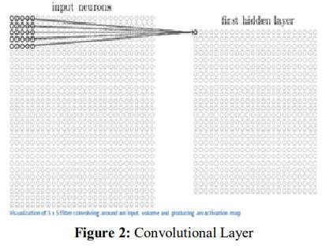
Dataset Details:
The initial experiment is done with 15 types of common vegetables that are found throughout the world. The vegetables that are chosen for the experimentation are- bean, bitter gourd, bottle gourd, brinjal, broccoli, cabbage, capsicum, carrot, cauliflower, cucumber, papaya, potato, pumpkin, radish and tomato. A total of 21000 images from 15 classes are used where each class contains 1400 images of size 224×224 and in *.jpg format. The dataset split 70% for training, 15% for validation, and 15% for testing purpose.
Content
This dataset contains three folders:
train (15000 images)
test (3000 images)
validation (3000 images)
each of the above folders contains subfolders for different vegetables wherein the images for respective vegetables are present.
Data Collection
The images in this dataset were collected by us from vegetable farm and market for a project.
Implementation Details:
Training ratio: 70%(approx.) and Number of images is 15000.
Validation ratio: 15%(approx.) and Number of images is 3000.

Slide 3
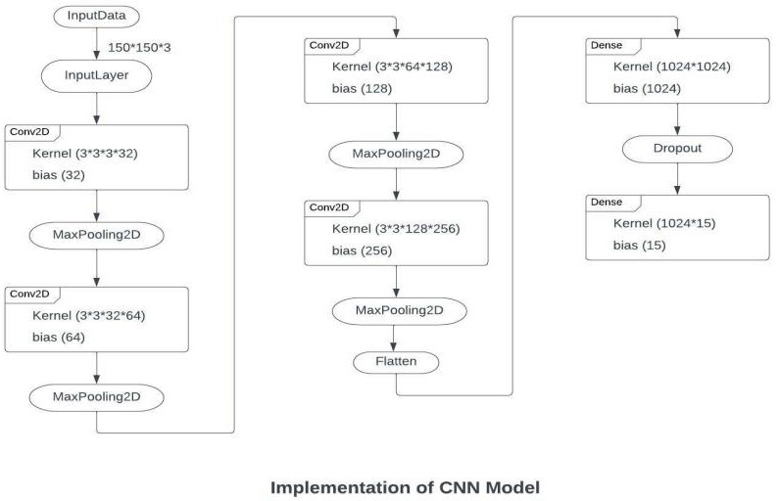
Testing ratio: 15%(approx.) and Number of images is 3000.
A block diagram of the implemented model to show the main steps:
epochs = 20
verbose = 1
batchSize = 64
stepsPerEpoch = 15000//batchSize
validationSteps = 3000//batchSize
imageSize = 150
seedNum = 42
classificationMode = raw
Optimizer = adam
Learning_rate = 0.0001
loss_function = sparse_categorical_crossentropy
Padding = same
strides = 1
activation = relu, softmax
Kernel_size = 3
4 conva layers
Layer1 filters = 16
Layer2 filters = 32
Layer3 filters = 128
Layer4 filters = 256

Slide 4
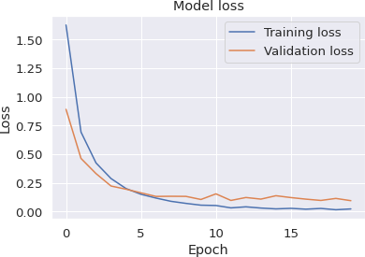
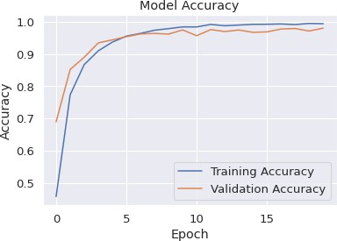
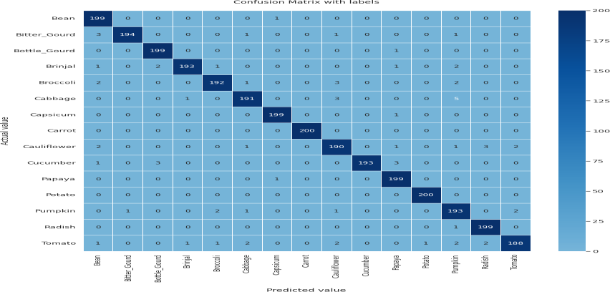
Results and Visualizations:
Accuracy
Loss Curve
Accuracy Curve
Confusion matrix

